Slide 1

UpGrad
FLOWER CLASSIFICATION USING CNN
NAME : Manish Kumar Das, Madhukar Reddy , Jaya Kishan , Anupam Aggarwal
REG NO :12017595 , 12016026 , 12017040 , 12017232
SECTION :K20UR
COURSE NAME : CSE 441 (INDUSTRY INTERNSHIP PROJECT)
MENTOR NAME : ADITHYA ADRAK

Slide 2
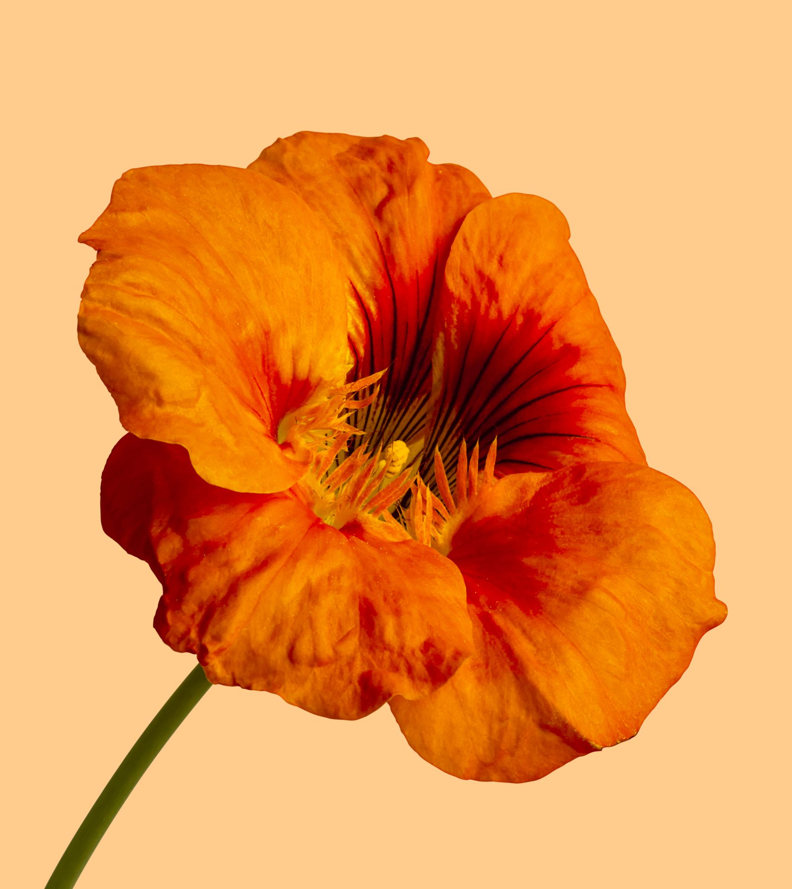
INTRODUCTION
Image classification is a fundamental task in computer vision, with numerous applications across various domains, including botany, agriculture, and horticulture. Accurate classification of flower species is crucial for plant identification, conservation efforts, and agricultural practices. However, the visual similarities and variations among different flower types pose significant challenges, making manual classification a time-consuming and error-prone process. This project aims to develop an automated and robust system for flower classification using advanced deep learning techniques.

Slide 3

PROBLEM STATEMENT
Despite the availability of various image classification methods, reliable and accurate flower classification remains a challenge. Existing solutions often struggle with the intricate details and subtle differences among flower species, leading to misclassifications. Moreover, the lack of large, diverse, and well-annotated flower datasets further complicates the development of robust models. This project addresses the need for an automated and accurate flower classification system by leveraging the power of deep learning and convolutional neural networks (CNNs).

Slide 4
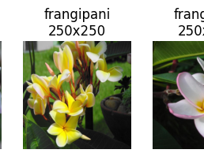
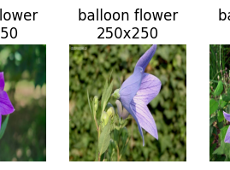

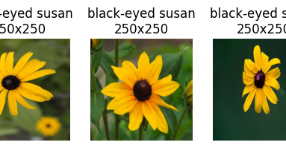
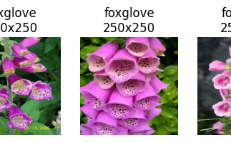
COLLECTING DATA
To train and evaluate the flower classification model, a comprehensive dataset was curated from multiple sources, including online repositories and personal collections. The dataset comprises [Approx 100 each] images spanning [20] different flower classes. The images were collected at various resolutions, with the majority being [224 * 224] pixels. Careful attention was paid to ensure diversity in terms of flower species, lighting conditions, backgrounds, and viewpoints to improve the model's generalization capabilities.

Slide 5
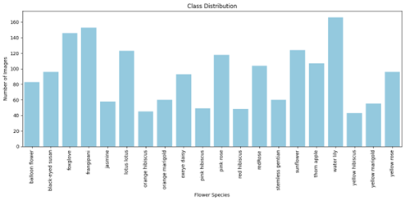
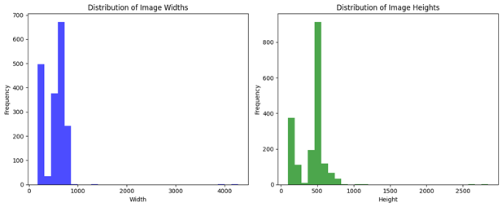
EXPLORATORY DATA ANALYSIS (EDA)
Exploratory data analysis (EDA) played a crucial role in understanding the characteristics and distributions of the flower dataset. Visualizations were created to analyse the class distributions, revealing colours and leaf patterns. Additionally, sample images were examined to identify potential challenges, such as Data Variety, Background Clutter, Lighting Variations, Viewpoint Variations and Blockages from direct view. These insights guided the subsequent data preprocessing and model development steps.

Slide 6
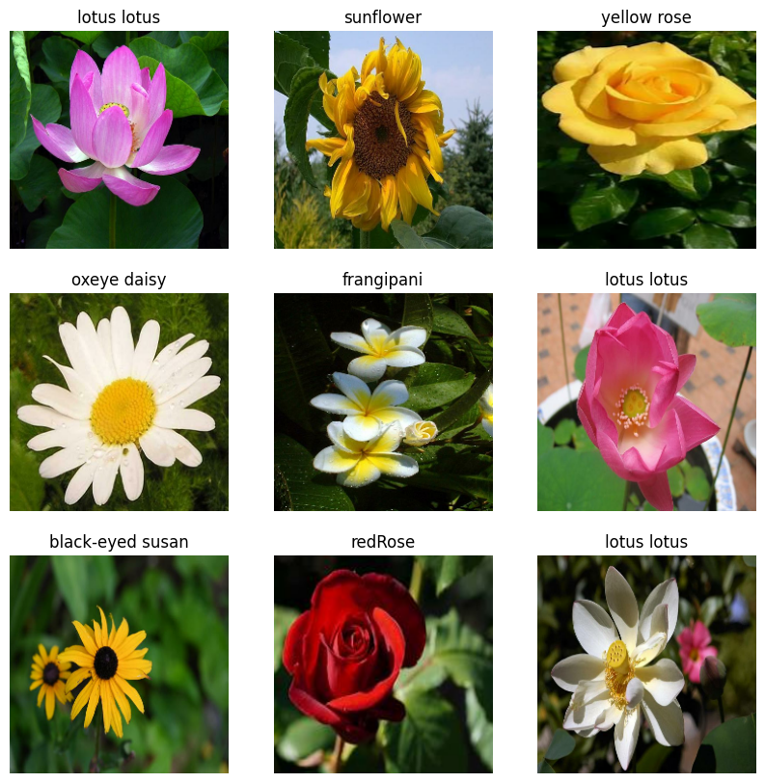
DATA PREPROCESSING
To prepare the dataset for model training, several data preprocessing techniques were employed. The images were rescaled to a consistent size of [224 * 224] pixels to ensure uniformity. Data augmentation techniques, including rotation, shifts, flips, and brightness adjustments, were applied to artificially increase the dataset size and improve the model's robustness to variations. Finally, the dataset was split into training and testing sets, with [90] of the data used for training and the remaining [10] for testing and evaluation.

Slide 7
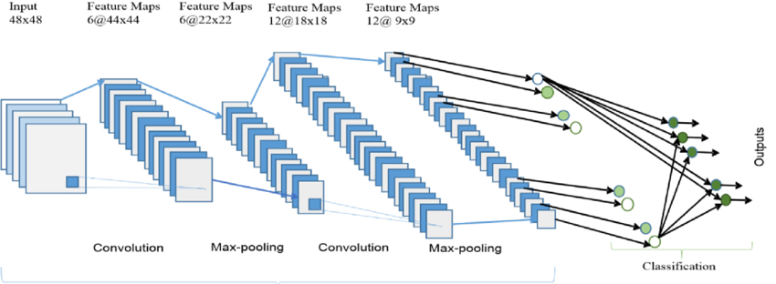
MODEL ARCHITECTURE
Convolutional Neural Networks (CNNs) are a powerful class of deep learning models widely used for image classification tasks. In this project, a custom CNN architecture was designed specifically for flower classification. The model consists of 3 convolutional layers, 2 max-pooling layers, and 20 dense layers. The convolutional layers are responsible for extracting low-level and high-level features from the input images, while the dense layers perform the final classification. Additionally, transfer learning techniques were employed by leveraging pre-trained models like ResNet and MobileNet. The pre-trained weights were used as a starting point, and new dense layers were added and fine-tuned for the specific task of flower classification.

Slide 8
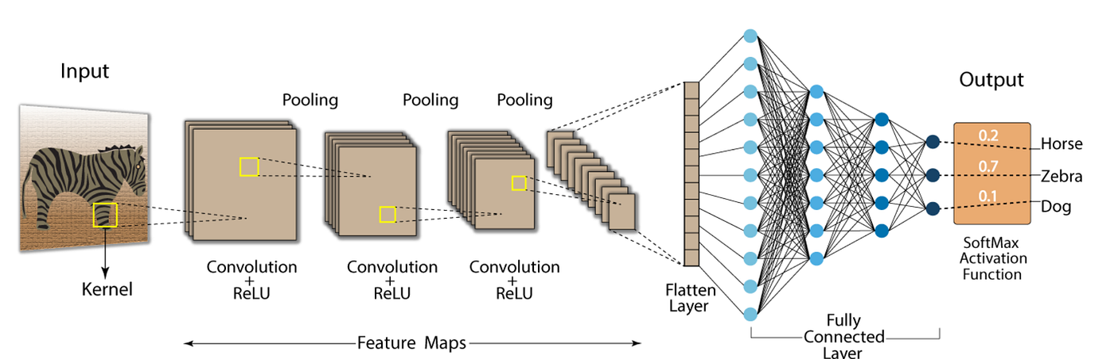
CONVOLUTIONAL NEURAL NETWORK(CNN)
Imagine you are looking at a picture of a dog. How can a computer recognize it's a dog and not a cat or a horse? This is where CNNs come in! CNNs are special computer programs inspired by the way our brains see.
Our brains see images piece by piece, like tiny squares. CNNs do the same! They break down an image into small parts, analyze each part, and then put everything together to understand the entire image.
Think of it like putting together a jigsaw puzzle. Each piece is a small part of the image, and the CNN figures out what each piece is and how they fit together to form the whole picture. By recognizing patterns in these pieces, the CNN can then identify objects like dogs, cats, or flowers in the image.

Slide 9

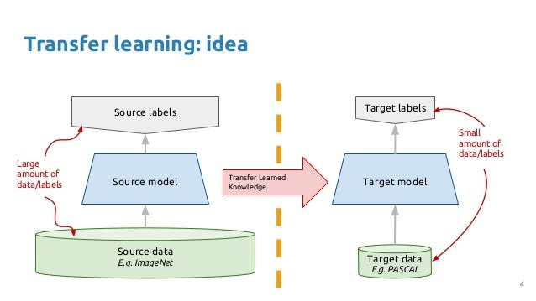
TRANSFER LEARNING
Imagine you're training a puppy to identify its toys. It learns what a ball looks like, the crinkle of a squeaky toy, and the fuzzy feeling of its favorite plushie.
Transfer learning is like teaching that same puppy a new trick, like fetching your slippers. It uses the knowledge it already has about finding things (like toys) and applies it to a similar task (finding slippers).
In machines, transfer learning takes a model trained on one task (like recognizing objects in photos) and uses that knowledge as a starting point for a new but related task (like telling different flower types apart in pictures). It's like giving the machine a head start by using what it already knows!

Slide 10
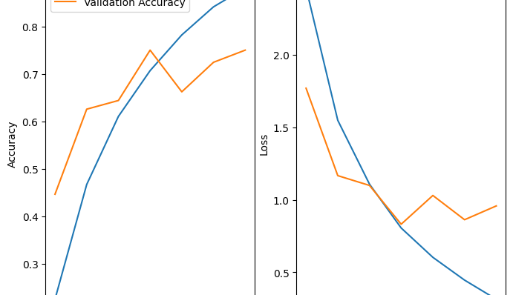
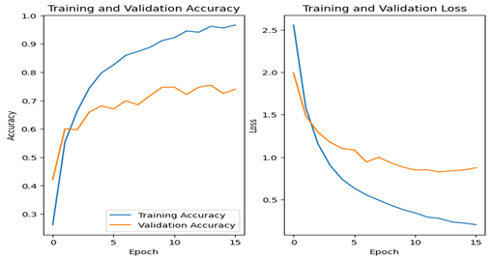
MODEL TRAINING
The model was trained using the [adam optimization algorithm] optimization algorithm and the [loss function] loss function. To evaluate the model's performance during training, the [evaluation metrics such as Loss and Accuracy] metrics were monitored. Regularization techniques, such as dropout and early stopping, were implemented to prevent overfitting and improve generalization. The model was trained for [20] epochs, with early stopping patience set to [20] epochs to stop training when the validation loss stopped improving.

Slide 11
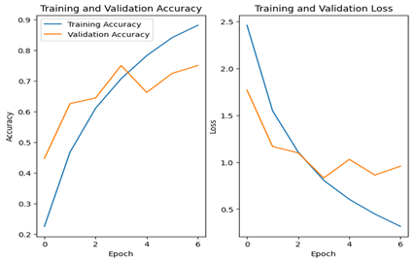
TRAINING AND VALIDATION PLOTS
The training and validation accuracy plots show 99% accuracy while Training and Validation Phase the dataset while a 90 % accuracy during Testing Phase. Similarly, the Loss Graphs plots reveal the system show a lower loss graph value signifying the system is working well and is well optimised . These plots provide insights into the model's learning behavior and help identify potential issues, such as overfitting or underfitting.

Slide 12
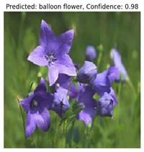
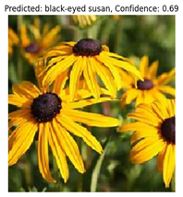
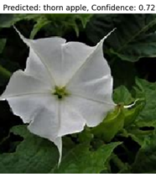
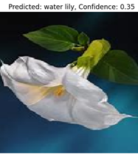
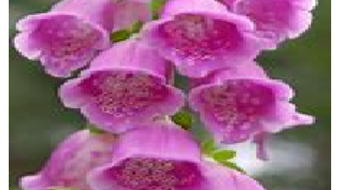
Results and Analysis
The developed flower classification model achieved promising results, showcasing its ability to accurately classify [20] different flower species. The model performed exceptionally well in classifying 20 flower classes with high accuracy when the flowers are in good viewing angles and with if surrounded with flowers of same species, likely due to their distinct visual features. However, challenges arose in distinguishing between some flower classes with similar leaf patterns and colours or even shape resulting in lower accuracy, which may be attributed to their similar appearances or the presence of confounding factors like occlusions or variations in lighting.

Slide 13
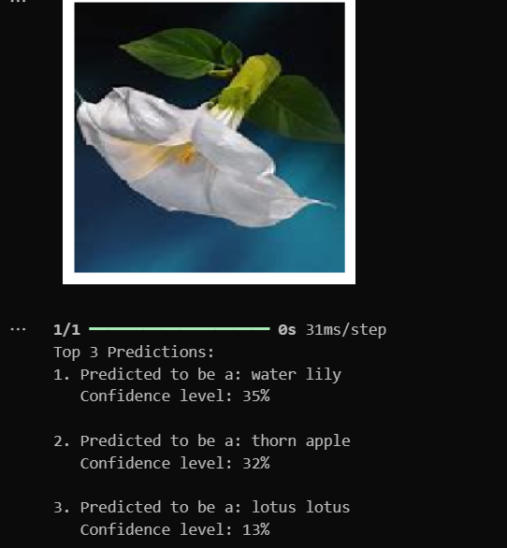
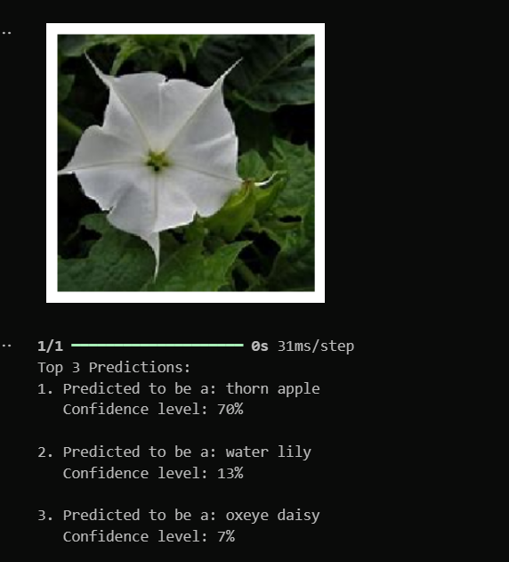
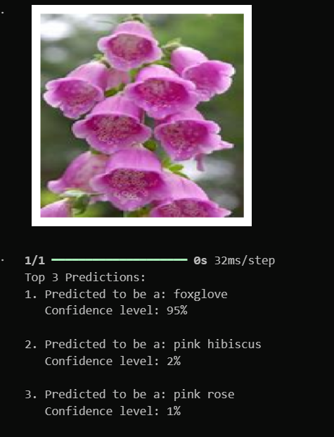
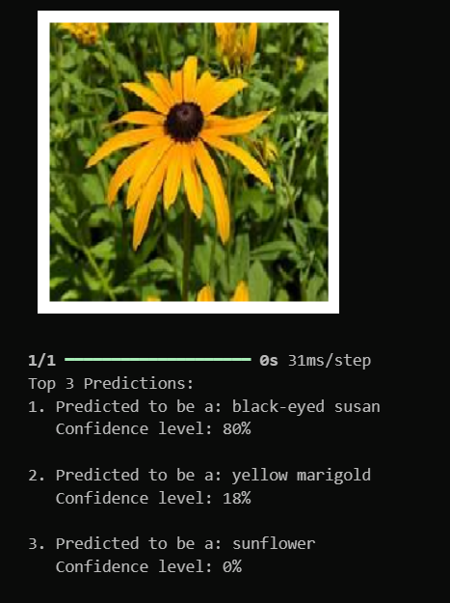
MODEL EVALUATION
After training, the model was evaluated on the held-out test dataset. The model achieved an overall test accuracy of 90 percent and a test loss of approx 10 percent. These results demonstrate the model's capability to accurately classify flower species from unseen images. However, there is still room for improvement, as certain classes exhibited lower accuracy rates, potentially due to system confusing the flowers due to same leaf patterns , colour , shape of petals or due to wrong viewing angles or brightness issues in the images. The Model might also confuse the flowers due to images containing flowers with same colour or patterns and even flower species which contains flowers with different colours like Roses .

Slide 14

DEPLOYMENT
To allow user engagement and demonstrate the Live AI capabilities, a web app was created using the Fast API framework. The glue gave a user-friendly interface for adding flower images and learned the known species captured from the knowledge base.
Application was deployed using Flask secured with tunnelling service to gain a remote entry point for testing and performance assessment.

Slide 15

Quantity: The training of deep learning models like CNNs with ResNets requires a ton of labelled flower image data. Too little data leads to overfitting, which is when the model will do exceptionally well on the training data and probably fail to generalize to yet-to-be-seen flowers.
Quality: The quality and variety of the training data are critically important for determining how well the model will do. Images with poor lighting, low resolution and cluttered background can be pretty much useless for the learning of a model on accurate representations of flowers.
Background Complexity: Flower images often feature background clutter or occlusion of the flower by other objects. Real-world situations often place flowers growing in gardens that are full of other plants, leaves, or debris in the frame.
CHALLENGES AND LIMITATIONS

Slide 16

conclusion
The Floral Sorcery strategy illustrated the possibility of deep learning methods in the exact identification of species of flowers and the capacity to link knowledge retrieval. The system has a friendly user-interface, which makes it easy to get information about the flowers that were identified on the site making it a useful tool to gardeners, botanists and nature lovers.
The future work will probably be related to broadening the dataset by adding various flower species, develop a more robust model, and enrich the knowledge base with more details about different species.
In addition, this system can be extended with interactive features like providing tips about growing plants or diverting your attention towards similar flower species to the identified flowers.

Slide 17

Future work
• Multiple data entry: Combining visual data with other information such as floral scent or leaf shape to better identify flowers. This enables the model to be trained on datasets containing odour clues captured by electronic noses or detailed leaf shapes extracted by image segmentation techniques.
• Real-time flower identification: Real-time flower identification that can process live video or analyse images captured by mobile devices instantly. This can be useful for applications such as on-the-go plant identification for nature enthusiasts or automated flower storage in cherry blossoms. Enabling real-time processing enables better model architectures and optimization techniques to be explored for faster inference of edge devices

Slide 18

references
1."Deep Learning-Based Flower Classification: A Survey" by N. G. E. Mostafa, A. G. Radwan, and H. S. A. Hamed. This paper provides an overview of various deep learning techniques, including CNNs, used for flower classification tasks.
2."Deep Learning for Flower Classification: A Comprehensive Review" by S. Mohanty, D. P. Hughes, and M. Salathé. This paper reviews deep learning approaches, particularly CNNs, applied to flower recognition tasks, highlighting different architectures and methodologies.
3."Plant Classification Using Convolutional Neural Networks" by A. Barczak, P. Skrzypczyński, and K. Wojdan. This paper focuses on using CNNs for plant species classification, including flower recognition, and discusses various CNN architectures and training techniques.

Slide 19

THANK YOU

